Slide 1
Pizza Sales Analysis
Using SQL

Slide 2
Overview:-
The goal of this SQL project is to analyze pizza sales data to gain insights into customer behavior, popular pizza types, sales trends, and overall performance. The analysis will be performed using four tables: order_details, orders, pizza_type, and pizza.

Slide 3
Dataset:-
1. order_details
• order_details_id: Unique identifier for the order detail.
• order_id: Identifier linking to the orders table.
• pizza_id: Identifier linking to the pizza table.
• quantity: Number of pizzas ordered.
2. orders
• order_id: Unique identifier for the order.
• date: Date the order was placed.
• time: Time the order was placed.
3.pizza_type
• pizza_type_id: Unique identifier for the pizza type.
• name: Name of the pizza.
• category: Category of the pizza (e.g., vegetarian, meat, etc.).
• ingredients: List of ingredients used in the pizza.
4. pizza
• pizza_id: Unique identifier for the pizza.
• pizza_type_id: Identifier linking to the pizza_type table.
• size: Size of the pizza (e.g., small, medium, large).
• price: Price of the pizza.

Slide 4
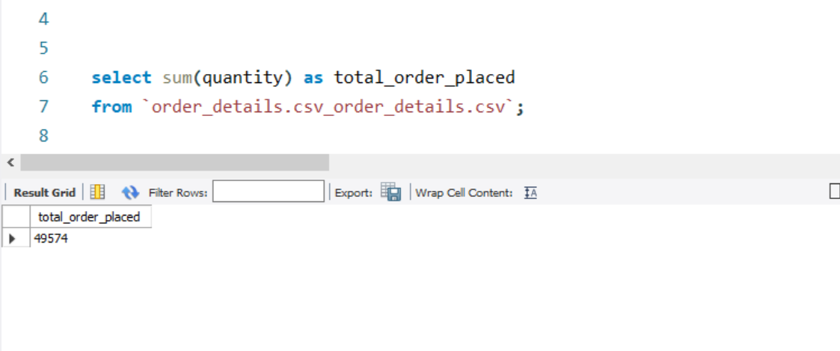
Q1. The total number of order place

Slide 5
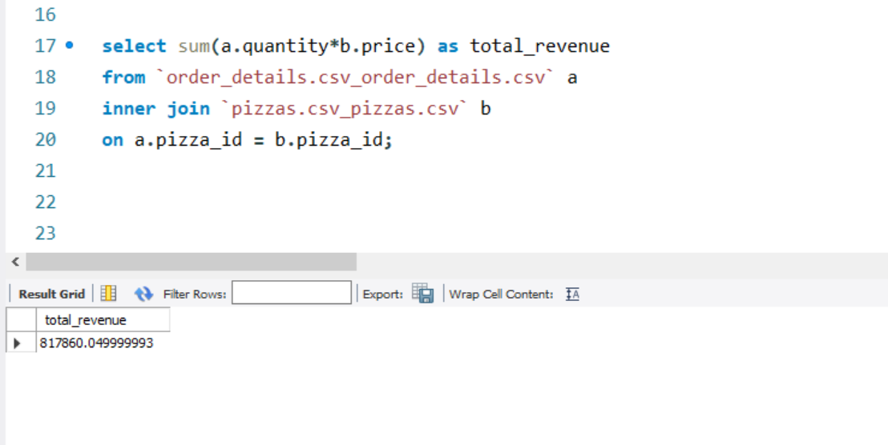
Q2. The total revenue generated from pizza sales

Slide 6
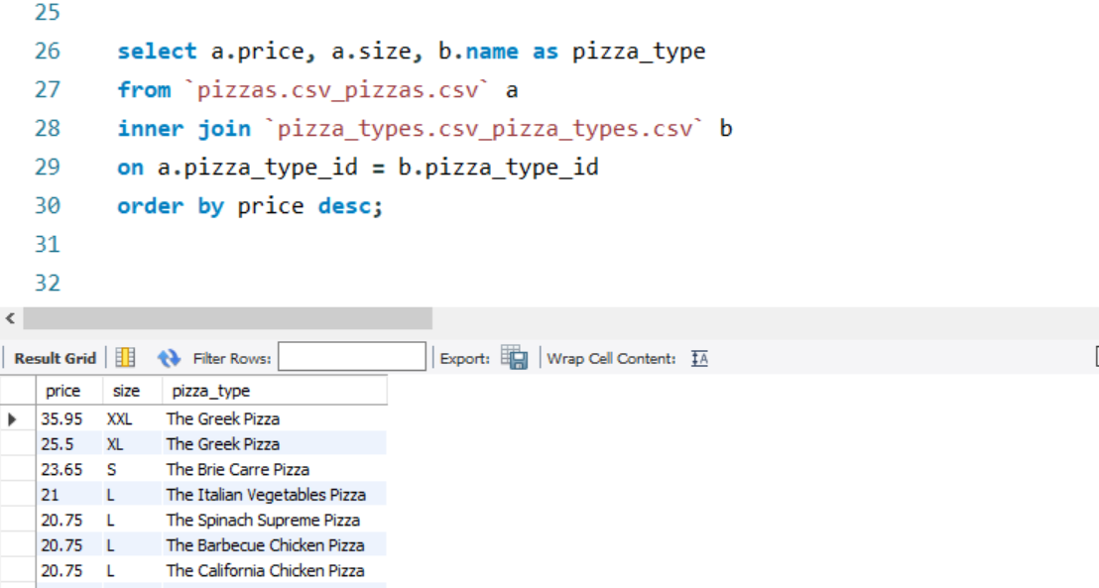
Q3. The highest priced pizza

Slide 7
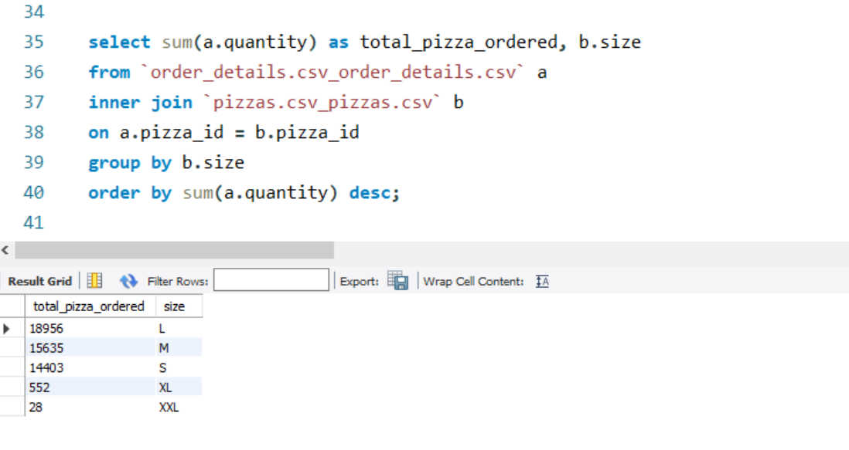
Q4. The most common pizza size ordered

Slide 8
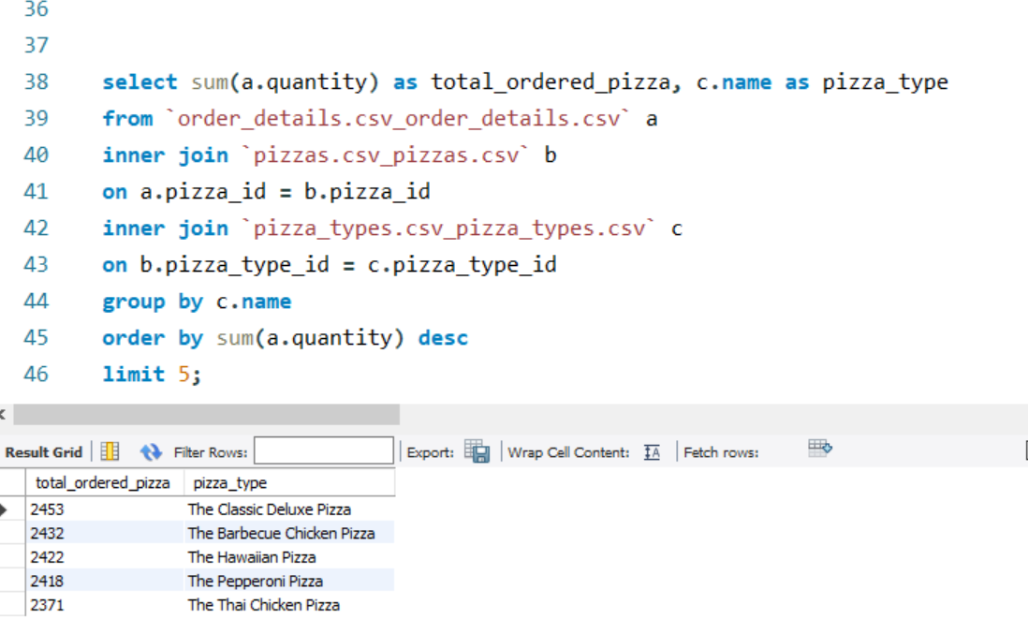
Q5. The top 5 most ordered pizza types along their quantities

Slide 9
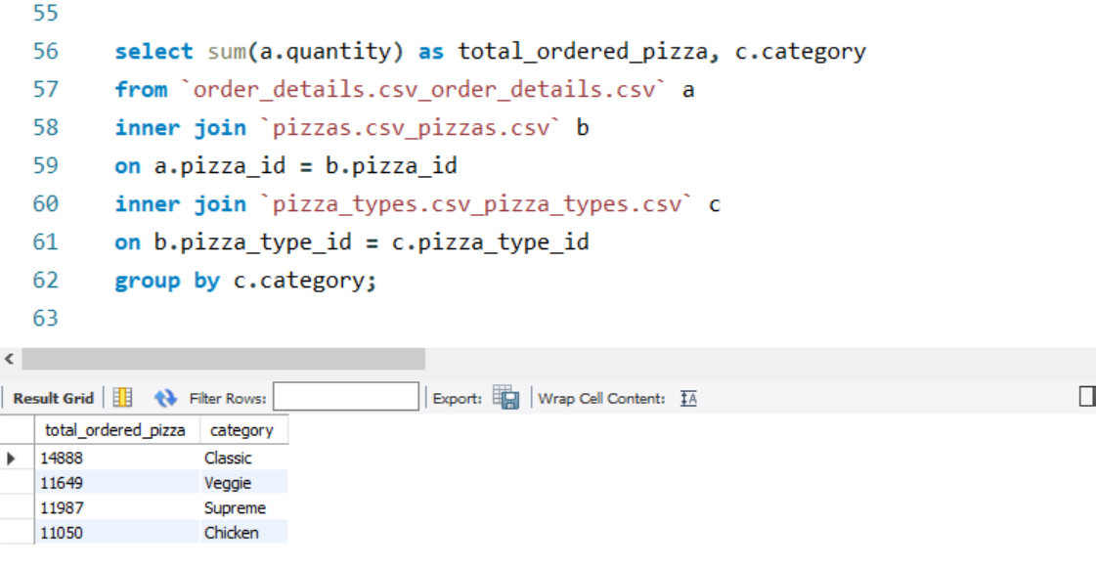
Q6. The quantity of each pizza categories ordered

Slide 10
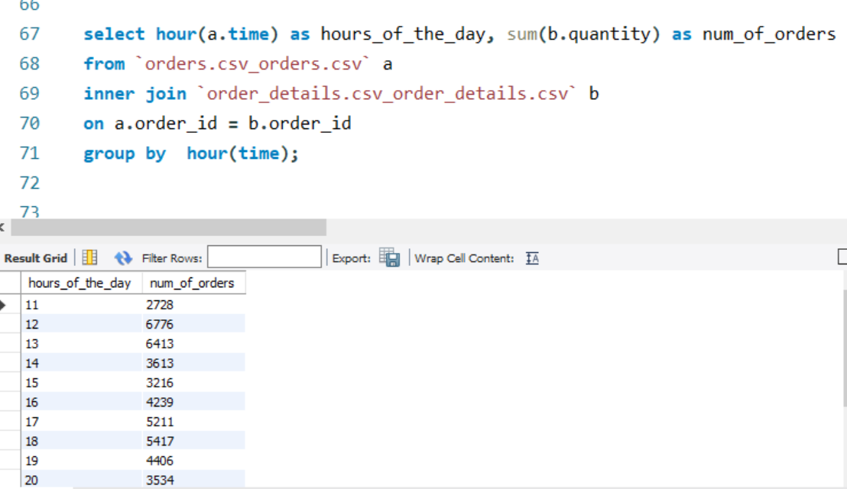
Q7. The distribution of orders by hours of the day

Slide 11
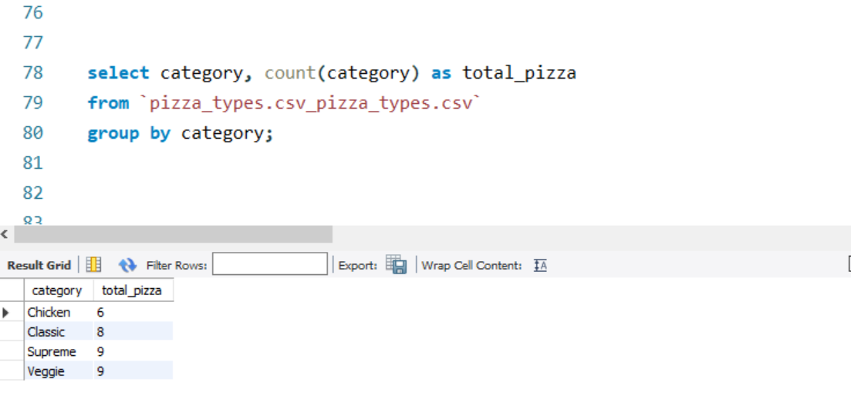
Q8. The category-wise distribution of pizzas

Slide 12
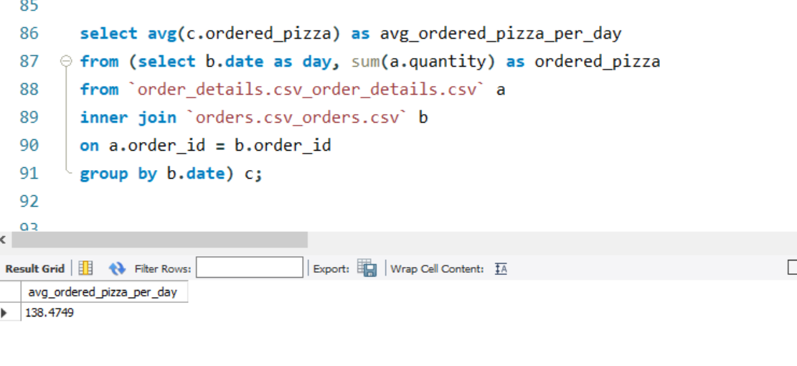
Q9. The average number of pizzas ordered per day

Slide 13
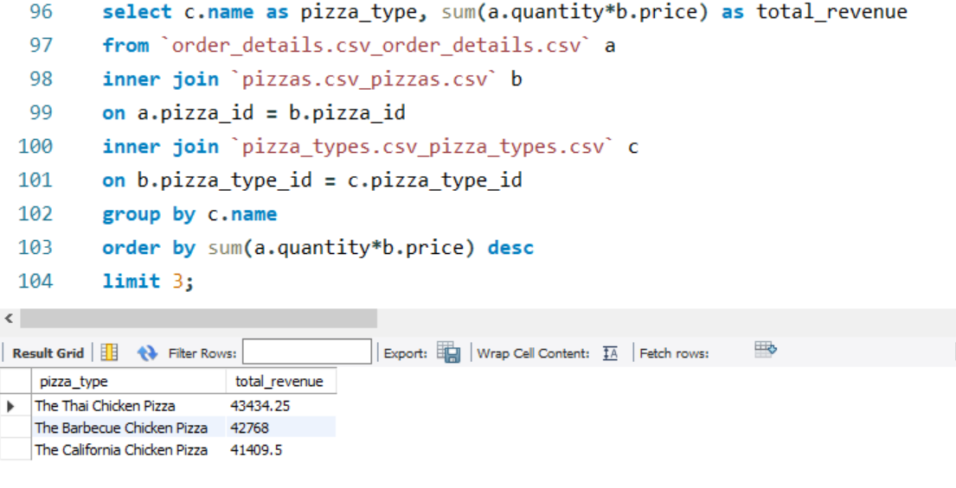
Q10. Top 3 most ordered pizza type base on revenue

Slide 14
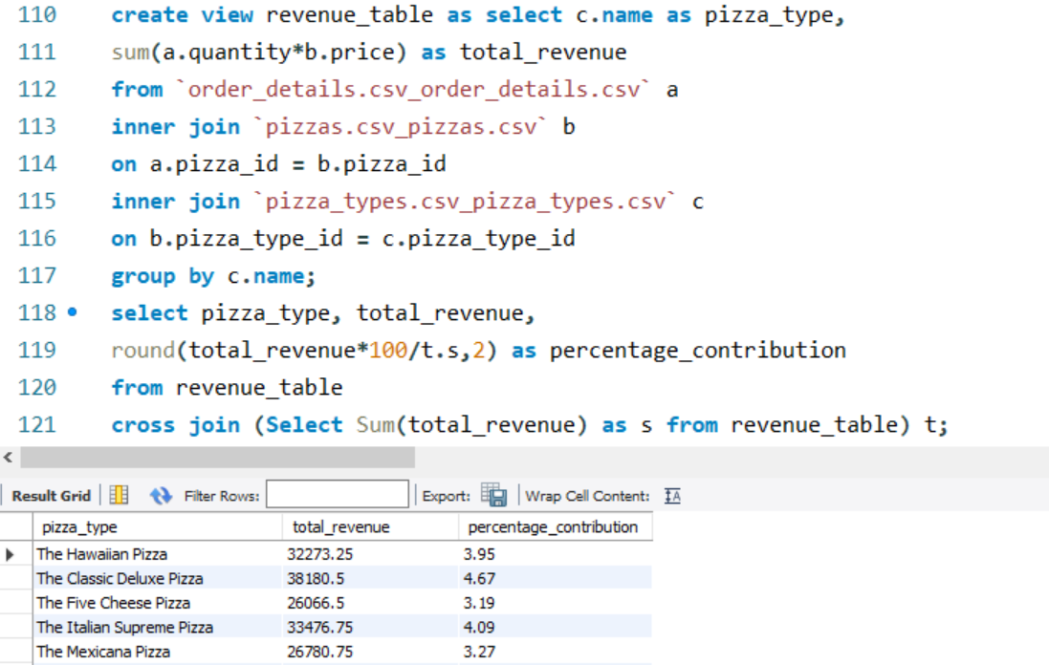
Q11. The percentage contribution of each pizza type to revenue

Slide 15
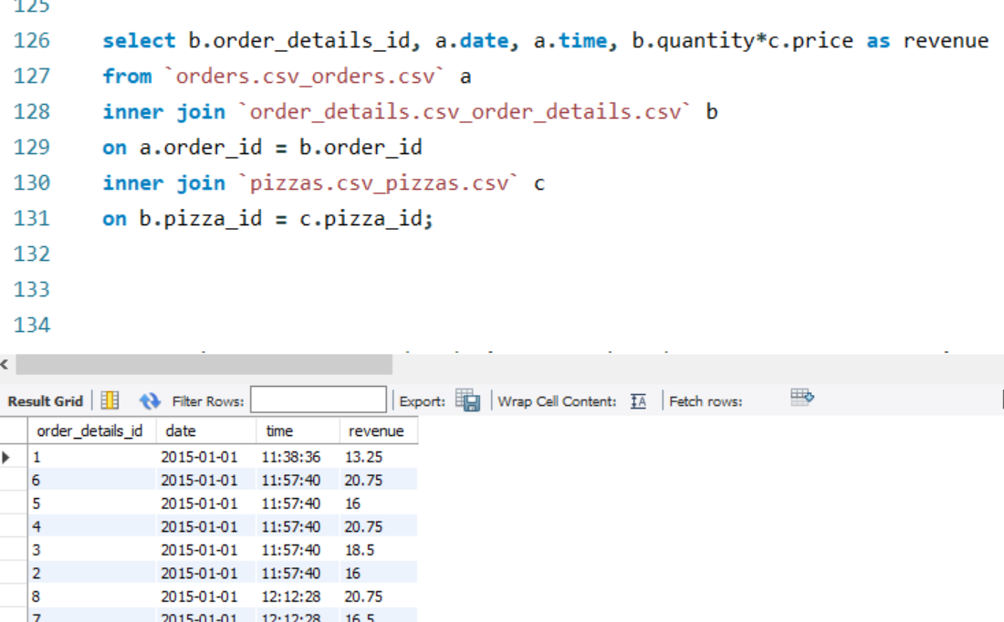
Q12. The cumulative revenue generated over time

Slide 16
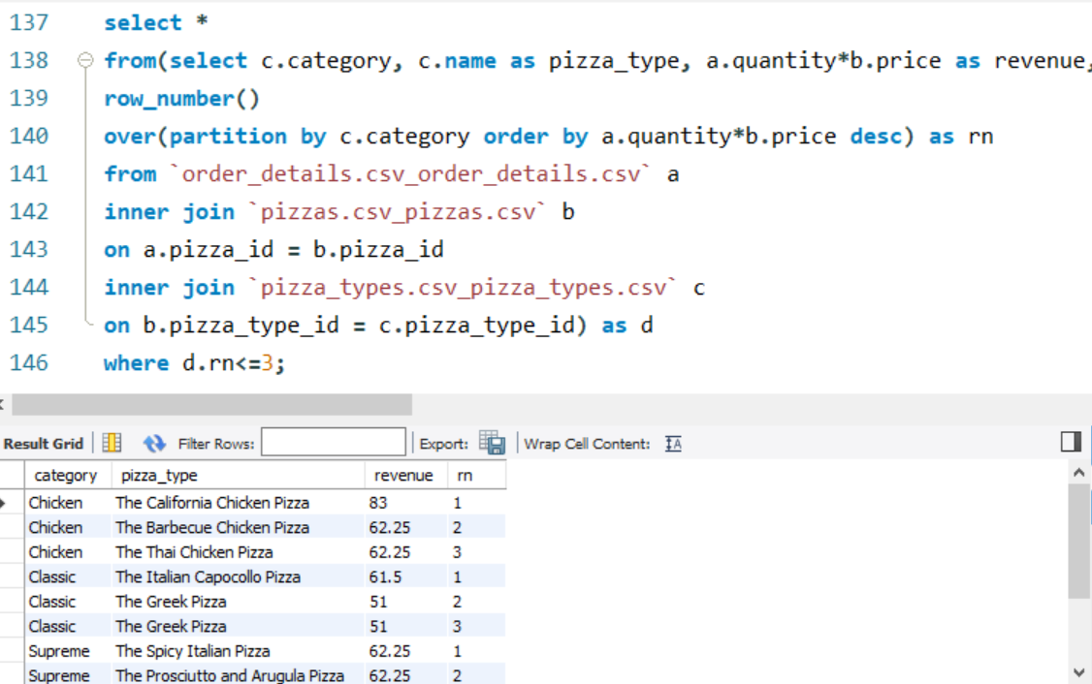
Q13. The top 3 most ordered pizza type based on revenue for each pizza category

Slide 17
Recommendations:-
Since large pizzas are the most ordered, consider offering deals and combos to encourage more purchases.
Considering the success of the Thai Chicken and Barbecue Chicken pizzas, explore adding new variations or seasonal specialties within the chicken category.
Leverage the popularity of large pizzas by suggesting upsells, such as extra toppings, side dishes, or beverages.
Actively seek customer feedback on the Greek Pizza XXL size and other premium items to understand their appeal and areas for improvement.

Slide 18
Thank You.

